Slide 1
Corn Ethanol: The Future or not?
Stephen Frazer

Slide 2
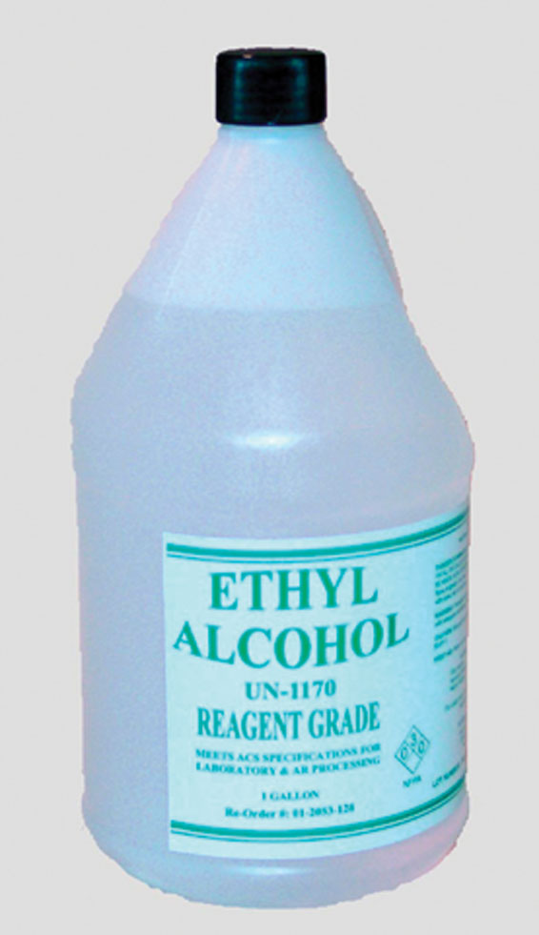
What is Ethanol fuel?
Ethyl alcohol
Renewable Energy Source
Sources
Sugar Cane
Switchgrass
Corn
Notes:
This is how is is made

Slide 3
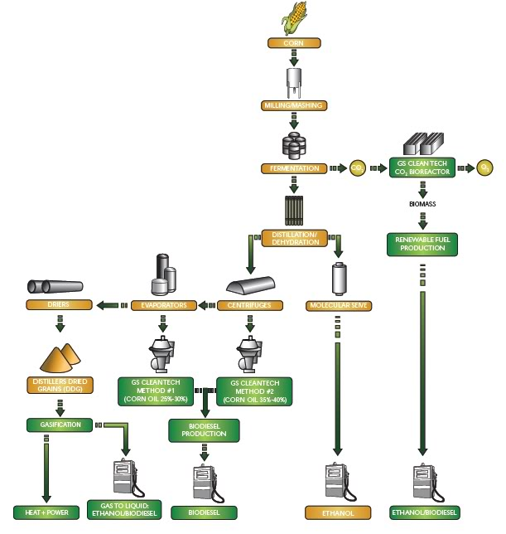
Corn Ethanol
Dry Milling
Wet Milling
Ethanol in America

Slide 4
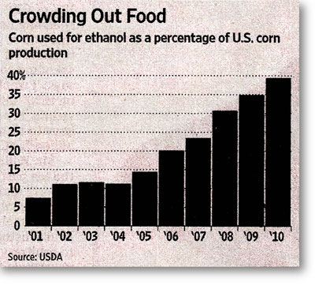
Environmental Factors
Land Use
Transportation
Byproducts

Slide 5
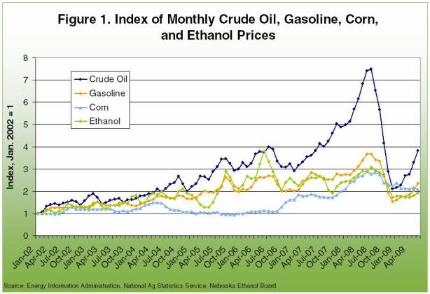
Economics
Shifts is Food Market
Oil/Corn Conversion
Subsidies and Tariffs

Slide 6
Politics
2007
Current Affairs
Video

Slide 7
Alternative Energy
Algae Biofuel
Electric powered cars

Slide 8
Work Cited
http://blog.caloricious.com/wp-content/uploads/2011/06/ethyl-alcohol.jpg
http://zfacts.com/p/63.html
http://green.autoblog.com/2009/08/13/greenlings-why-is-there-ethanol-in-gasoline/
http://www.cars.com/go/advice/Story.jsp?section=fuel&subject=fuelAlt&story=e85
http://biggovernment.com/cprandoni/2011/06/13/the-problem-with-ethanol-is-the-mandate/
http://en.wikipedia.org/wiki/Ethanol_fuel_in_the_United_States#History_of_ethanol_in_the_U.S
.
http://www.usda.gov/wps/portal/usda/usdahome?navid=TOPICS

